Slide 1


Nodejs Basics
Autumn – 2021
Mostafavi
01 – What is node.js

Slide 2
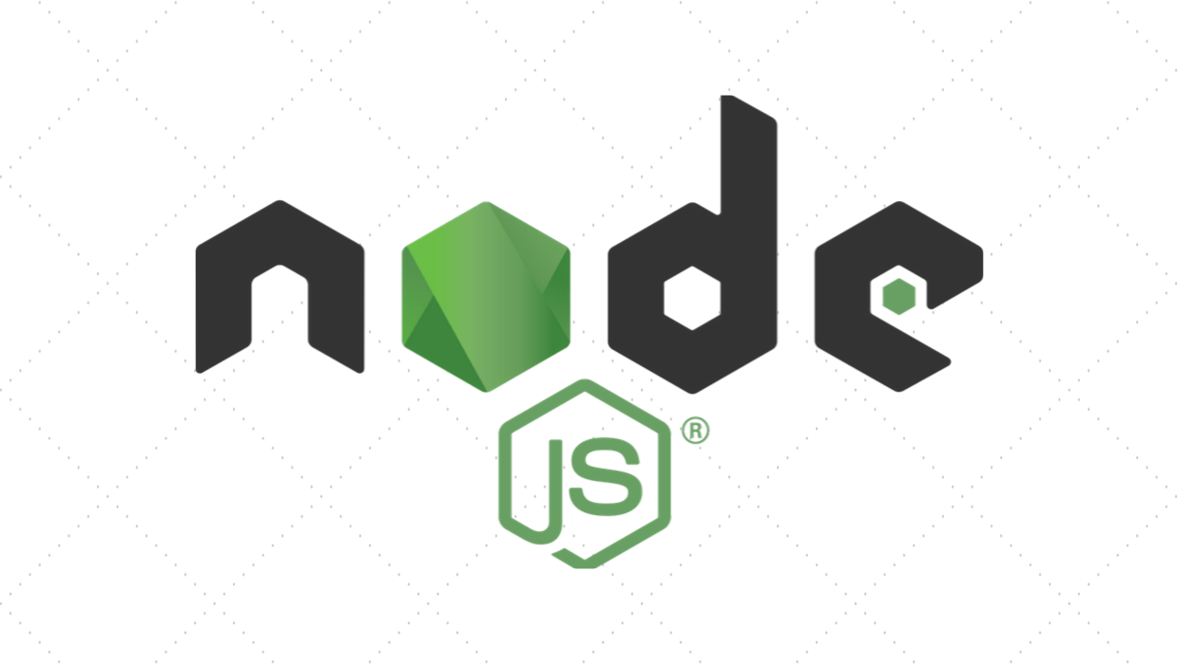

Slide 3
JS in browser
JS engine
JS code
Machine code

Slide 4
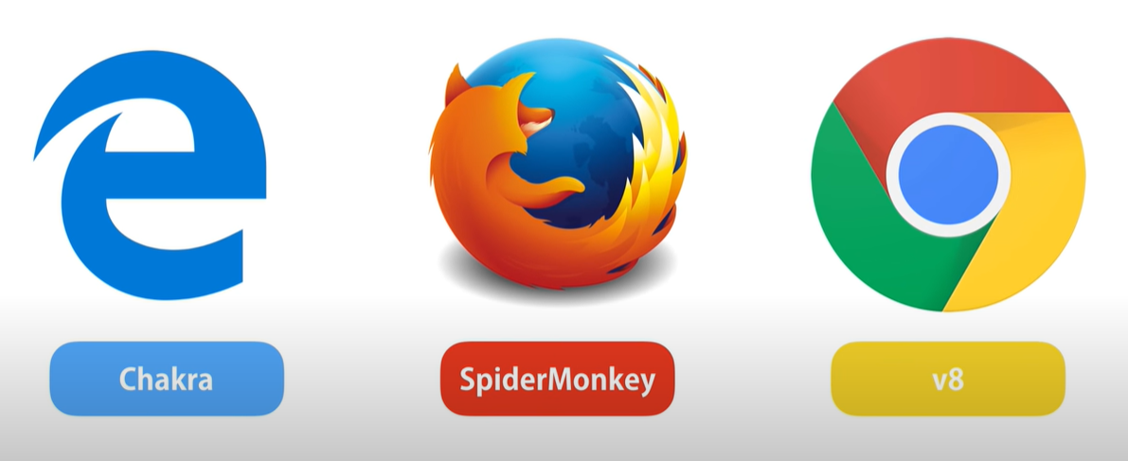
Engines

Slide 5
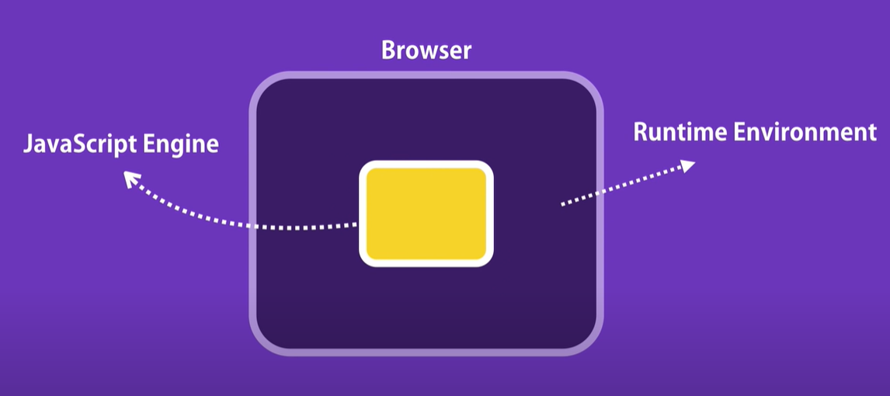
Where and what?

Slide 6
Browser main object
document.getElementById(‘’);

Slide 7
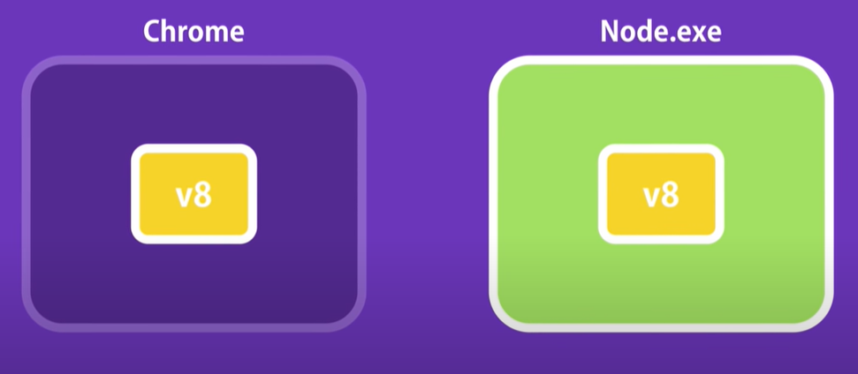
Where is node?

Slide 8
Browser main object
document.getElementById(‘’);
fs.readfile();
http.createServer();

Slide 9
Language, framework, or what?
What is Node.js?
Is it a language?
Or a framework?
Or what?

Slide 10
Runtime environment for js code
Main features:
Great for prototyping and agile development
Superfast and highly scalable (use in paypal)
Built twice as fast with fewer people
33% fewer lines of code
40% fewer files
2x request/sec
35% faster response time
Javascript everywhere
Cleaner and more consistent codebase
Large ecosystem of open-source libs (npm)

Slide 11
What is node.js?
Node.js provides a non-blocking architecture using event loop processing based on single threaded JavaScript model and built on top of Google’s V8 JavaScript Engine.

Slide 12
Non-blocking

Slide 13
Non-blocking

Slide 14
Non-blocking
Non-blocking execution means asynchronous execution.
All APIs of Node.js library are asynchronous and non-blocking.
Node.js server never waits for an API to return data. Server moves to next API after calling it and a notification mechanism of Events of Node.js helps server to get response from the previous API call.

Slide 15
Blocking

Slide 16
Non-blocking

Slide 17
Event loop
Event loop processing in Node.js is a programming style where the flow of execution is determined by events.
Events are handled by event handlers or event callbacks.
An event callback is a function that is invoked when something significant happens such as when the result of a database query is available.

Slide 18
Single Threaded
Node is a single-threaded environment. At most, only one line of your code will ever be executing at any time.
Note: event loop in Node.js is just one thread running inside one process, which means that, when an event happens, the event handler can run without interruption.

Slide 19
History
Node.js was invented in 2009 by Ryan Dahl along with other developers while working at Joyent.
The Node.js’ Package Manager (NPM) was introduced in 2011, allowing publishing and sharing node.js source code by the community.
Node.js was originally developed for the Linux environment.
The first node.js to support Windows was released in July 2011.
Node.js went through several technical changes including internal conflict over Joyent’s governance, resulting Fedor Indutny (Node.js core team developer) in December 2014 starting io.js, a fork of Node.js.

Slide 20
History
In February 2015, the Node.js foundation was announced, providing the opportunity of merging Node.js and io.js communities together under the Node.js foundation.
On Oct12, 2015, Node 4.2.0 (LTS) was announced, the first release covered under the new LTS plan (Long Term Support).
Node’s core functionalities are kept to a minimum.
There are many third-party modules supporting Node.js and can be downloaded, installed, and managed using Node Package Manager (NPM) to expand node’s functionalities.

Slide 21
Install
Just go to the website and install it ☺
Ensure you install it correctly:
node --version

Slide 22
demo
First program
Using function with console
Can we access window object?

Slide 23
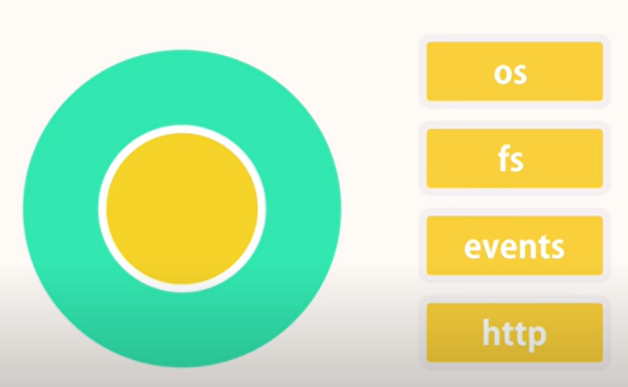
Modules

Slide 24
Demo
Global object (access everywhere)
console
setTimeout
clearTimeout
setInterval
clearInterval
We access global functions and variables from window, where in node?
global
Variables do not added in global object

Slide 25
Demo
Global object
Functions with same names in different file.
There, it comes modularity
Evert file is module
All variables and functions are private, we have to export them.
Module object, what is it?
console.log(module);
Create a module
Logger
module.exports.log = log;
module.exports = log;

Slide 26

Exports, imports

Slide 27
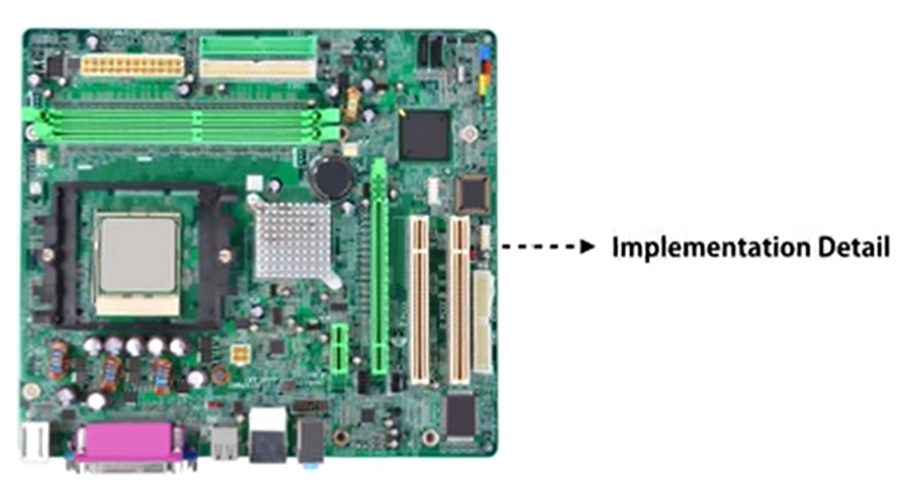
Exports, imports

Slide 28
Course Structure
What is Node.js?
Node.js built-in modules
NPM
Asynchronous js
Built RESTFUL API using Node.js, Express & Javascript
Typescript
Build a RESTful API with Node.js, Express & TypeScript
Express – advanced topics:
Middlewares, Environments, Configuration, Debugging, Template engines, Structuring folders,

Slide 29
Demo
Import module
Require
Destruct
console.log(require());
const vs var
Error in compile time

Slide 30
Demo
Module wrapper function
Add a syntactical error in the first line
We see the function wrapper
Code wraps each module in a function
module.exports
exports

Slide 31
Demo
Path module
https://nodejs.org/dist/latest-v16.x/docs/api/path.html
const path = require(‘path’);
path.parse(__filename);

Slide 32
Demo
OS Module
https://nodejs.org/dist/latest-v16.x/docs/api/os.html
const os = require(‘os’);
os.totalmem();
os.freemem();
ES6 -> template sctring
console.log(`Total memory: ${}’);

Slide 33
Demo
Filesystem module
https://nodejs.org/dist/latest-v16.x/docs/api/fs.html
const fs = require(‘fs’);
Blocking
const data = fs.readFileSync("./test.txt");
console.log(data.toString());
console.log("This statement runs after read file!");
Non-blocking
const fs = require("fs");
fs.readFile("./test.txt", (err, data) => {
if(err) console.log("Read error!!");
console.log(data.toString());
});
console.log("This statement runs after read statement?");

Slide 34
Demo
Events
https://nodejs.org/dist/latest-v16.x/docs/api/events.html
const EventEmitter = require(‘events’);
const eventEmitter = new EventEmitter();
Class vs Object
emitter.emit(‘event’); //Raise an event
emitter.on(‘event’, function(){}); //Register a listener
Arguments?
Pass through objects, it is better.
Anonymous functions

Slide 35
Demo
Extending event emitter
Use module
Why we need a class? addListerenet does not work (different classes)
Use class (with extension)
Class Logger extends EventEmitter { this.emit(‘event’);}

Slide 36
Demo
HTTP module
https://nodejs.org/dist/latest-v16.x/docs/api/http.html
const http = require(‘http’);
const server = http.createServer();
Server.listen(3000);
Event:
server.on(‘connection’, function(socket){});
Request, Response
const server = http.createServer((req, res) => {});
Notes:
const server = http.createServer((req, res) => {
if (req.url === ‘/’) {
res.write(‘Hello worlk’);
res.end();
}
// and so on… use JSON
});

Slide 37
Exercise
What is REPL Module?
What is 12 factor?
How REPL is related to 12 factor??

